Slide 1

Adventure Works

Slide 2

Table of Contents
Introduction
Data Overview
Reason for High & Low Performance
Dashboards
Recommendations
Conclusion

Slide 3
Introduction
Adventure Works Cycles, the company on which the Adventure Works sample databases are based, is a large, multinational manufacturing company.
The company manufactures and sells metal and composite bicycles to North American, European and Asian commercial markets. While its base operation is in Bothell, Washington with 290 employees, several regional sales teams are located throughout their market base.
In 2000s, Adventure Works Cycles bought a small manufacturing plant in Mexico.
Which manufactures several critical subcomponents for the Adventure Works Cycles product line.
These subcomponents are shipped to the Bothell location for final product assembly. In 2001, this manufacturing plant became the sole manufacturer and distributor of the touring bicycle product group.
Coming off a successful fiscal year, Adventure Works Cycles is looking to broaden its market share by targeting their sales to their best customers, extending their product availability through an external Web site, and reducing their cost of sales through lower production costs.

Slide 4

Reason for the Profit Gained
High Sales in Key Region:-
Australia ($9.06M) and Southwest ($5.72M) contributed significantly to total sales and profit.
Strong market presence and demand in these regions.
Top-Selling Product Lines:-
Sport-100 Helmet, Red (78,028 units) drove major sales, showcasing customer preference for premium products.
Other high-performing products like Water Bottles and Mountain Tire Tubes indicate a diverse product range contributing to revenue.

Slide 5
Reason for Low Performance
Underperforming Region:
Central Southeast and Northeast regions recorded negligible sales, impacting overall performance.
Likely causes : weak marketing, lack of distribution networks, or limited customer base in these area.
Product Concentration Risk:
Heavy reliance on the Sport-100 Helmet for sales may pose a risk if demand drops.
Lack of focus on improving the performance of other products.

Slide 6
Low Q1 Sales($5.52M) :
Seasonal demand drop or inadequate marketing strategies at the start of the year.
Tax and Operational Costs:
While the dashboard doesn’t specify operational costs,the $2.3M tax might be impacting net profit margins.

Slide 7
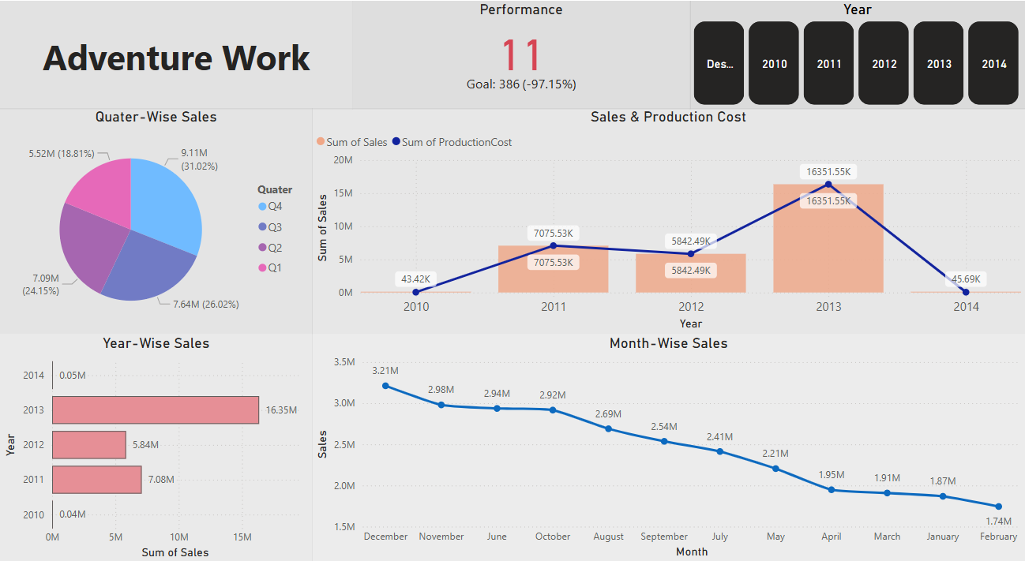
Power BI Dashboard

Slide 8

Solutions to Increase the Sales
Expand Market Reach in Low-Performing Regions:
Strategies:
1. Invest in marketing campaigns to raise awareness.
2. Partner with local distributors or e-commerce platforms in
Southeast and Northeast and Central Regions.
Outcome : Increase regional sales contribution.

Slide 9
Promote Underperforming Products:
Strategies:
1. Bundle slower-moving products with popular iteams
2. Introduce discounts or promotional offers for these products.
Outcomes : Broader product sales distribution.
Leverage Q4 Trends:
Strategies:
1. Extend holiday promotions to Q3 to preempt competition.
2. Increase inventory for high-demand products before Q4.
Outcome: Enhanced revenue consistency across quarters.

Slide 10
Product Innovation and Diversification:
Launch variations of top-performing products.
Introduce complementary products to increase cross-selling opportunities.
Optimize Pricing Strategies:
Analyse competitor pricing to ensure competitive rates.
Offer loyalty programs or volume discounts to retain customers.
Invest in Customer Insights:
Use customer feedback to tailor products and marketing strategies.
Run surveys to understand preferences in underperforming regions.

Slide 11
Improve Tax Efficiency:
Review Tax policies and explore opportunities for tax credits or Deductions.
Optimize logistics to reduce tax burdens across regions.

Slide 12
Conclusion
The sales dashboard provides valuable insights into the overall performance of Adventure Works from 2010 to 2014. Key findings include:
Strong Sales and Profit Performance:
Total sales amounted to $29.36M, with a profit of $12.1M, driven primarily by Australia and high-performing products like the Sport-100 Helmet.
Regional and Product Disparities:
While some regions, such as Central and Southeast, contributed minimally, strong sales in Australia and Southwest regions balanced overall performance. Similarly, certain products underperformed compared to top sellers.
Seasonal Trends:
Q4 emerged as the most profitable quarter, highlighting the impact of seasonal demand and end-of-year consumer behavior.
Areas for Improvement:
Expanding into underperforming regions, diversifying product focus, and leveraging existing strengths in high-demand products and regions can boost overall growth.

